Slide 1
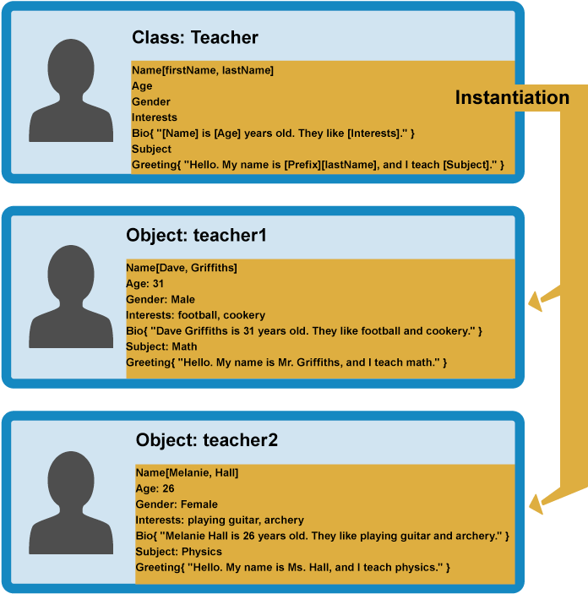
Objects and Classes
Using Objects and Classes Defining Simple Classes
SoftUni Team
Technical Trainers
Software University
https://softuni.bg

Slide 2
Table of Contents
Objects
Definition, properties and methods
Object methods
Object iteration
2. Reference vs. Value Types
3. JSON
4. Classes

Slide 3
Have a Question?
sli.do
#fund-js

Slide 4

Objects
Definition, Properties and Methods

Slide 5
What Are Objects ?
Collection of related data or functionality
Consists of several variables and functions called properties and methods
In JavaScript, at run time you can add and remove properties of any object
Object name
Property name
let obj = { name:'Peter', age: 20 };
console.log(obj.name); // Peter
Property value

Slide 6
Object Definition
We can create an object with an object literal, using the following syntax:
let person = {name:'Peter', age: 20, hairColor: 'black'};
We can define empty object and add the properties later
let person = {};
person.name ='Peter';
person["lastName"] = 'Parker';
person.age = 20;
person.hairColor = 'black';
You can access and set properties using both ways

Slide 7
Problem: Person Info
Create an object that has first name, last name and age
Return the object at the end of your function
Peter
Pan
20
firstName: Peter
lastName: Pan
age: 20
Jack
Sparrow
unknown
firstName: Jack
lastName: Sparrow
age: unknown

Slide 8
Solution: Person Info
Create an object
Set the properties firstName, lastName and age
Return the created object using return keyword
function personInfo(firstName, lastName, age) {
let person = {};
person.firstName = firstName;
// TODO: Add other properties
return person;
}

Slide 9
Methods of Objects
Functions within a JavaScript object are called methods
We can define methods using several syntaxes:
We can add a method to an already defined object
let person = { sayHello : function() {
console.log('Hi, guys');
} }
let person = {
sayHello() {
console.log('Hi, guys');
}
}
let person = { name:'Peter', age: 20 };
person.sayHello = () => console.log('Hi, guys');

Slide 10
Built-in Object Methods
Methods:
Object.entries() - returns array of tuples all properties and their values of an object
Object.keys() - returns array with all the properties
Object.values() - returns array with all the values of the properties
Object.entries(cat); // [['name', 'Tom'], ['age', 5]]
Object.keys(cat); // ['name', 'age']
Object.values(cat); // ['Tom', 5]

Slide 11
Iterate Through Keys
Use for-of loop to iterate over the object properties by key:
let obj = { name:'Peter', age:'18', grade:'5.50' }; for (let key of Object.keys(obj)) { console.log(`${key}: ${obj[key]}`); }
Returns the value of the property

Slide 12
Problem: City
Receive an object, which holds name, area, population, country and post code
Loop through all the keys and print them with their values
Sofia
492
1238438
Bulgaria
1000
name -> Sofia
area -> 492
population -> 1238438
country -> Bulgaria
postCode -> 1000

Slide 13
Solution: City
Get the object entries
Loop through the object entries using for-of loop
Print the object keys and values
function cityInfo(city) { let entries = Object.entries(city); for (let [ key, value ] of entries) { console.log(`${key} -> ${value}`); }
}

Slide 14
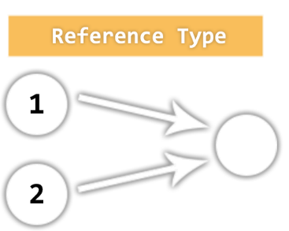
Value vs. Reference Types
Memory Stack and Heap

Slide 15
Reference vs. Value Types
JavaScript has 7 data types that are copied by value:
Boolean, String, Number, null, undefined, Symbol, BigInt
These are primitive types
JavaScript has 3 data types that are copied by having their reference copied:
Array, Objects and Functions
These are all technically Objects, so we'll refer to them collectively as Objects

Slide 16
Example: Reference vs. Value Types

Slide 17
Value Types
If a primitive type is assigned to a variable, we can think of that variable as containing the primitive value
They are copied by value
let a = 10; let c = a; let b = 'abc'; let d = b;
console.log(a, b, c, d); // a = 10 b = 'abc' c = 10 d = 'abc'

Slide 18
Reference Types
Variables that are assigned a non-primitive value are given a reference to that value
That reference points to a location in memory
Variables don't actually contain the value but lead to the location
let arr = []; let arrCopy = arr;

Slide 19

JSON
JavaScript Object Notation

Slide 20
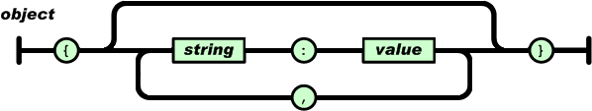
What is JSON
JSON stands for JavaScript Object Notation
Open-standard file format that uses text to transmit data objects
JSON is language independent
JSON is "self-describing" and easy to understand

Slide 21
JSON Usage
Exchange data between browser and server
JSON is a lightweight format compared to XML
JavaScript has built in functions to parse JSON so it's easy to use
JSON uses human-readable text to transmit data

Slide 22
JSON Example
Brackets define a JSON
{
"name": "Ivan",
"age": 25,
"grades": {
"Math": [2.50, 3.50],
"Chemistry": [4.50]
}
}
It is possible to have nested objects
Keys are in double quotes
Keys and values separated by :
In JSON we can have arrays

Slide 23
JSON Methods
We can convert object into JSON string using JSON.stringify(object) method
We can convert JSON string into object using JSON.parse(text) method
let text = JSON.stringify(obj);
let obj = JSON.parse(text);

Slide 24
Problem: Convert to Object
Write a function, that receives a string in JSON format and converts it to object
Print the entries of the object
'{
"name": "George", "age": 40, "town": "Sofia“
}'
name: George
age: 40
town: Sofia

Slide 25
Tips: Convert to Object
Use JSON.parse() method to parse JSON string to an object
Use Object.entries() method to get object's properties: names and values
Loop through the entries and print them
function objConverter(json) { // TODO: Use the tips to write the function }

Slide 26
Solution: Convert to Object
function objConverter(json) { let person= JSON.parse(json);
let entries = Object.entries(person);
for (let [key, value] of entries) {
console.log(`${key}: ${value}`);
} }

Slide 27
Problem: Convert to JSON
Write a function that receives first name, last name, hair color and sets them to an object
Convert the object to JSON string and print it
'George', 'Jones',
'Brown'
{"firstName": "George", "lastName": "Jones", "hairColor": "Brown"}

Slide 28
Tips: Convert to JSON
Create an object with the given input
Use JSON.stringify() method to parse object to JSON string
Keep in mind that the property name in the JSON string will be exactly the same as the property name in the object
function solve(name, lastName, hairColor){ // TODO: Use the tips and write the code }

Slide 29
Solution: Convert to JSON
function convertJSON(name, lastName, hairColor) { let person = {
name,
lastName,
hairColor
};
console.log(JSON.stringify(person));
}

Slide 30
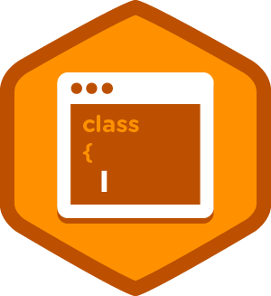
Classes
Object Models

Slide 31
What Are Classes
Extensible program-code-template for creating objects
Provides initial values for the state of an object
An object created by the class pattern is called an instance of that class
A class has a constructor - subroutine called to create an object
It prepares the new object for use

Slide 32
Class Declaration
To declare a class we use the class keyword with the name of the class.
class Student {
constructor(name) {
this.name = name;
}
}
The constructor is a special method for creating and initializing an object

Slide 33
Class Example
Creating a class:
Creating an instance of the class:
class Student {
constructor(name, grade) {
this.name = name;
this.grade = grade;
}
}
this keyword is used to set a property of the objects to a given value
let student = new Student('Peter', 5.50);

Slide 34
Functions in a Class
Classes can also have functions as property, called methods:
class Dog {
constructor() {
this.speak = () => {
console.log('Woof');
}
}
}
let dog = new Dog();
dog.speak(); // Woof
We access the method as a regular property

Slide 35
Problem: Cat
Write a function that receives array of strings in the following format: '{cat name} {age}'
Create a class Cat that receives the name and the age parsed from the input
It should also have a function named meow() that will print "{cat name}, age {age} says Meow" on the console
For each of the strings provided you must create a cat object
['Mellow 2','Tom 5']
Mellow, age 2 says Meow
Tom, age 5 says Meow

Slide 36
Tips: Cat
Create a class
Set properties name and age
Set property 'meow' to be a function that prints the result
Parse the input data
Create all objects using class constructor and the parsed input data and store them in an array
Loop through the array using for…of loop and invoke .meow() method

Slide 37
Solution: Cat
function catCreator(arr) { // TODO: Create the Cat class
let cats = [];
for (let i = 0; i < arr.length; i++) { let catData = arr[i].split(' '); let [name, age] = [catData[0], catData[1]]; cats.push(new Cat(name, age));
}
// TODO: Iterate through cats[] and invoke .meow() using for…of loop
}

Slide 38

Live Exercises

Slide 39

Summary
Objects hold key-value pairs
Access key and value
Use Object Methods
Value vs. Reference types
Parse and stringify objects in JSON
Classes

Slide 40
Questions?
Notes:
40

Slide 41











SoftUni Diamond Partners

Slide 42



Educational Partners

Slide 43
Trainings @ Software University (SoftUni)
Software University – High-Quality Education, Profession and Job for Software Developers
softuni.bg
Software University Foundation
softuni.foundation
Software University @ Facebook
facebook.com/SoftwareUniversity
Software University Forums
forum.softuni.bg
Notes:
43

Slide 44

License
This course (slides, examples, demos, exercises, homework, documents, videos and other assets) is copyrighted content
Unauthorized copy, reproduction or use is illegal
© SoftUni – https://about.softuni.bg/
© Software University – https://softuni.bg
Notes:
44

